Slide 1
WIND AND WATER POWER TECHNOLOGIES OFFICE
2014 Wind Technologies Market Report: Summary
Ryan Wiser & Mark Bolinger
Lawrence Berkeley National Laboratory
August 2015

Slide 2
2014 Wind Technologies Market Report
Purpose, Scope, and Data:
Publicly available annual report summarizing key trends in the U.S. wind power market, with a focus on 2014
Scope primarily includes wind turbines over 100 kW in size
Separate DOE-funded annual reports on distributed and offshore wind
Data sources include AWEA, EIA, FERC, SEC, etc. (see full report)
Report Authors:
Primary authors: Ryan Wiser and Mark Bolinger, Berkeley Lab
Contributions from others at Berkeley Lab, Exeter Associates, NREL
Funded by: U.S. DOE Wind & Water Power Technologies Office
Available at: http://energy.gov/eere/wind

Slide 3
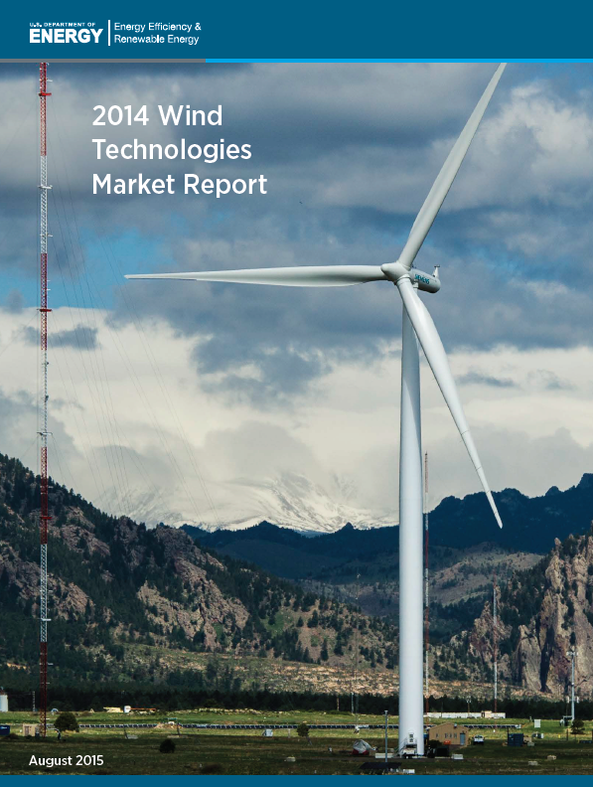
Report Contents
Installation trends
Industry trends
Technology trends
Performance trends
Cost trends
Wind power price trends
Policy & market drivers
Future outlook

Slide 4
Key Findings
Annual wind capacity additions rebounded in 2014, with significant additional new builds anticipated for 2015 and 2016
Wind has been a significant source of new electric generation capacity additions in the U.S. in recent years
Supply chain has been under duress, but domestic manufacturing content for nacelle assembly, blades, and towers is strong
Turbine scaling is boosting expected wind project performance, while the installed cost of wind projects is on the decline
Wind power sales prices have reached all-time lows, enabling economic competitiveness despite low natural gas prices
Growth after 2016 remains uncertain, dictated in part by future natural gas prices and policy decisions, though recent declines in the price of wind energy boost future growth prospects
Notes:
4

Slide 5
Installation Trends

Slide 6
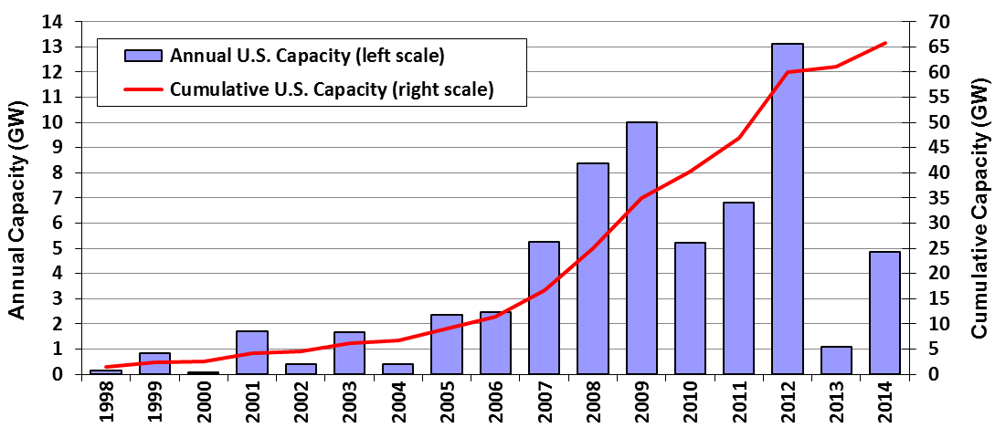
Wind Power Additions Rebounded in 2014, with 4,854 MW of New Capacity Added
$8.3 billion invested in wind power project additions in 2014
Wind build well off annual additions from 2007 through 2012
Cumulative wind capacity up nearly 8%, bringing total to 65.9 GW

Slide 7
Wind Power Represented 24% of Electric-Generating Capacity Additions in 2014
From 2007-2014, wind comprised 33% of capacity additions nation-wide, and a much higher proportion in some regions

Slide 8
The U.S. Placed 3rd in Annual Wind Power Capacity Additions in 2014
Global wind additions reached a new high in 2014
U.S. remains a distant second to China in cumulative capacity
U.S. led the world in wind energy production in 2014

Slide 9
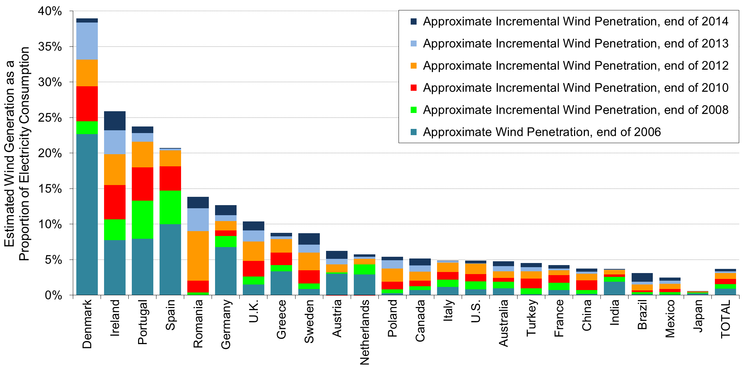
U.S. Lagging Other Countries in Wind As a Percentage of Electricity Consumption
Note: Figure only includes the countries with the most installed wind power capacity at the end of 2014

Slide 10
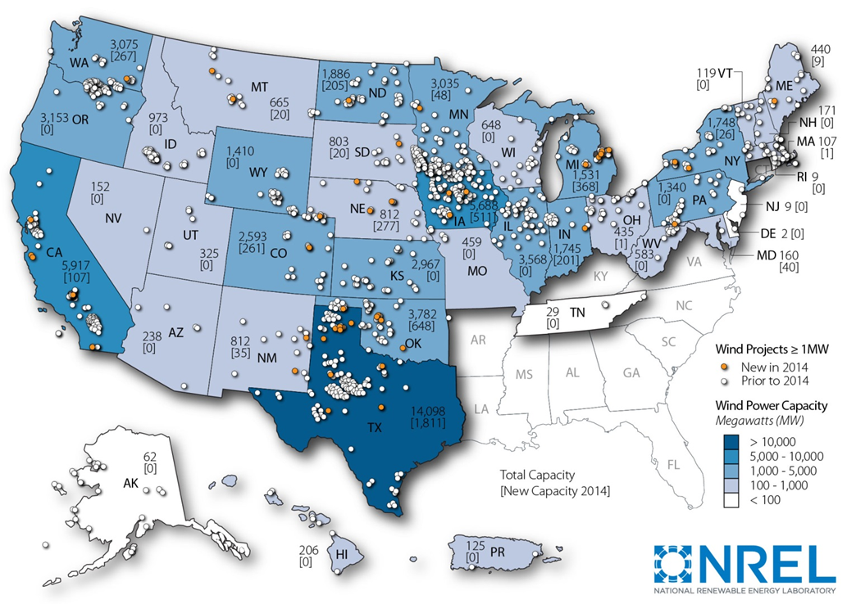
Geographic Spread of Wind Projects in the United States Is Reasonably Broad
Note: Numbers within states represent cumulative installed wind capacity and, in brackets, annual additions in 2014
Notes:
10

Slide 11
Texas Installed the Most Capacity in 2014; 9 States Exceed 12% Wind Energy
Texas has more than twice as much wind capacity as any other state
23 states had >500 MW of capacity at end of 2014 (16 > 1 GW, 10 > 2 GW)
2 states have >25% of total in-state generation from wind (9 states > 12%)
Notes:
11

Slide 12
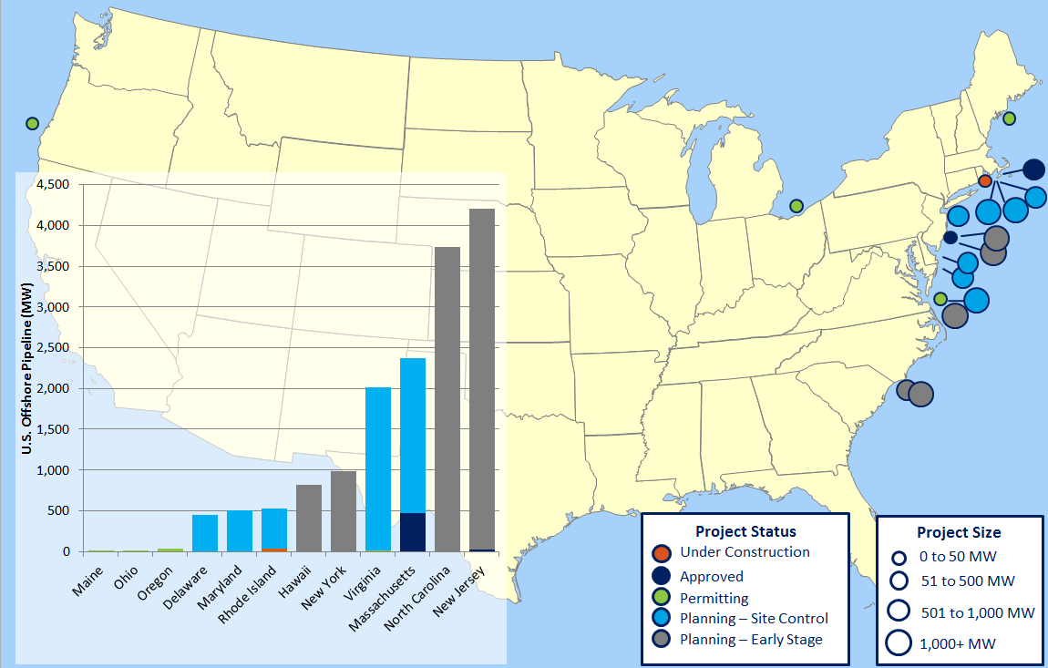
No Commercial Offshore Wind Turbines Commissioned; 1 Project in Construction and 18 in Various Stages of Development
30 MW Block Island project (RI) started construction in 2015
BOEM has granted 5 competitive leases; DOE funding 3 pilot deployments
Legal and political headwind for high-profile projects:
Cape Wind (MA) power purchase agreements cancelled by utilities
Fishermen’s Atlantic City (NJ) rejected by state PUC
Dominion (VA) announced delay due to cost
Pressing challenges include cost, lack of PPAs and policy incentives, regulatory complexity

Slide 13
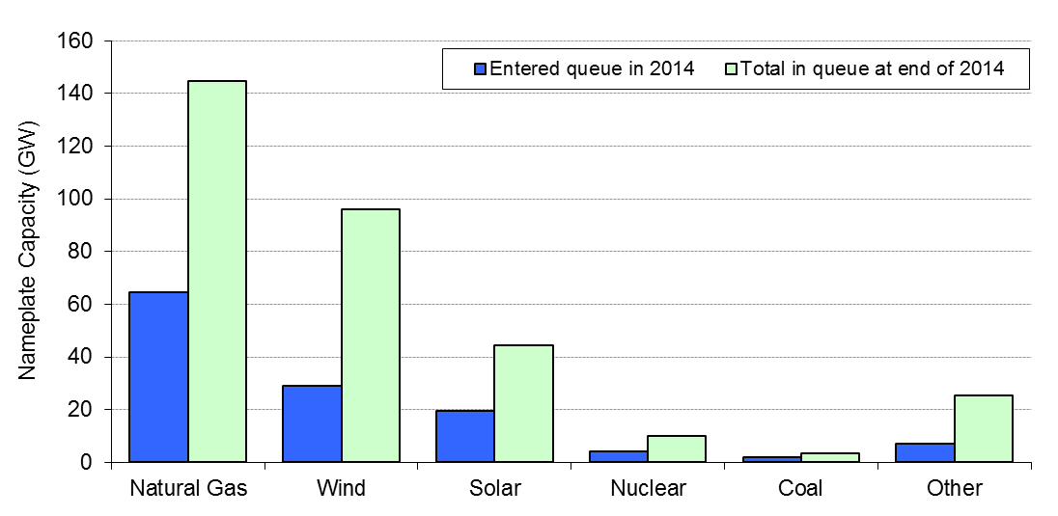
Interconnection Queues Demonstrate that a Substantial Amount of Wind Is Under Consideration
Wind represented 30% of capacity in sampled 35 queues
But… absolute amount of wind (and coal & nuclear) in sampled queues has declined in recent years whereas natural gas and solar capacity has increased
Not all of this capacity will be built….
AWEA reports 13.6 GW of capacity under construction after 1Q2015

Slide 14
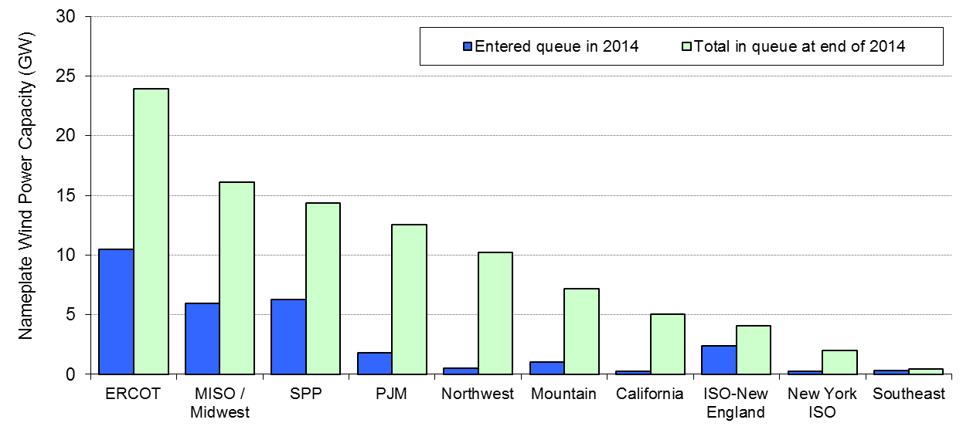
Larger Amounts of Wind Planned for Texas, Midwest, Southwest Power Pool, PJM, and Northwest
Not all of this capacity will be built….

Slide 15
Industry Trends

Slide 16
GE, Siemens, and Vestas Captured 98% of the U.S. Market in 2014
Recent dominance of the three-largest turbine suppliers in the U.S. market
Globally, Vestas remained the top supplier, followed by Siemens and GE
Chinese suppliers occupied 8 of the top 15 spots in the global ranking, based almost entirely on sales within their domestic market

Slide 17
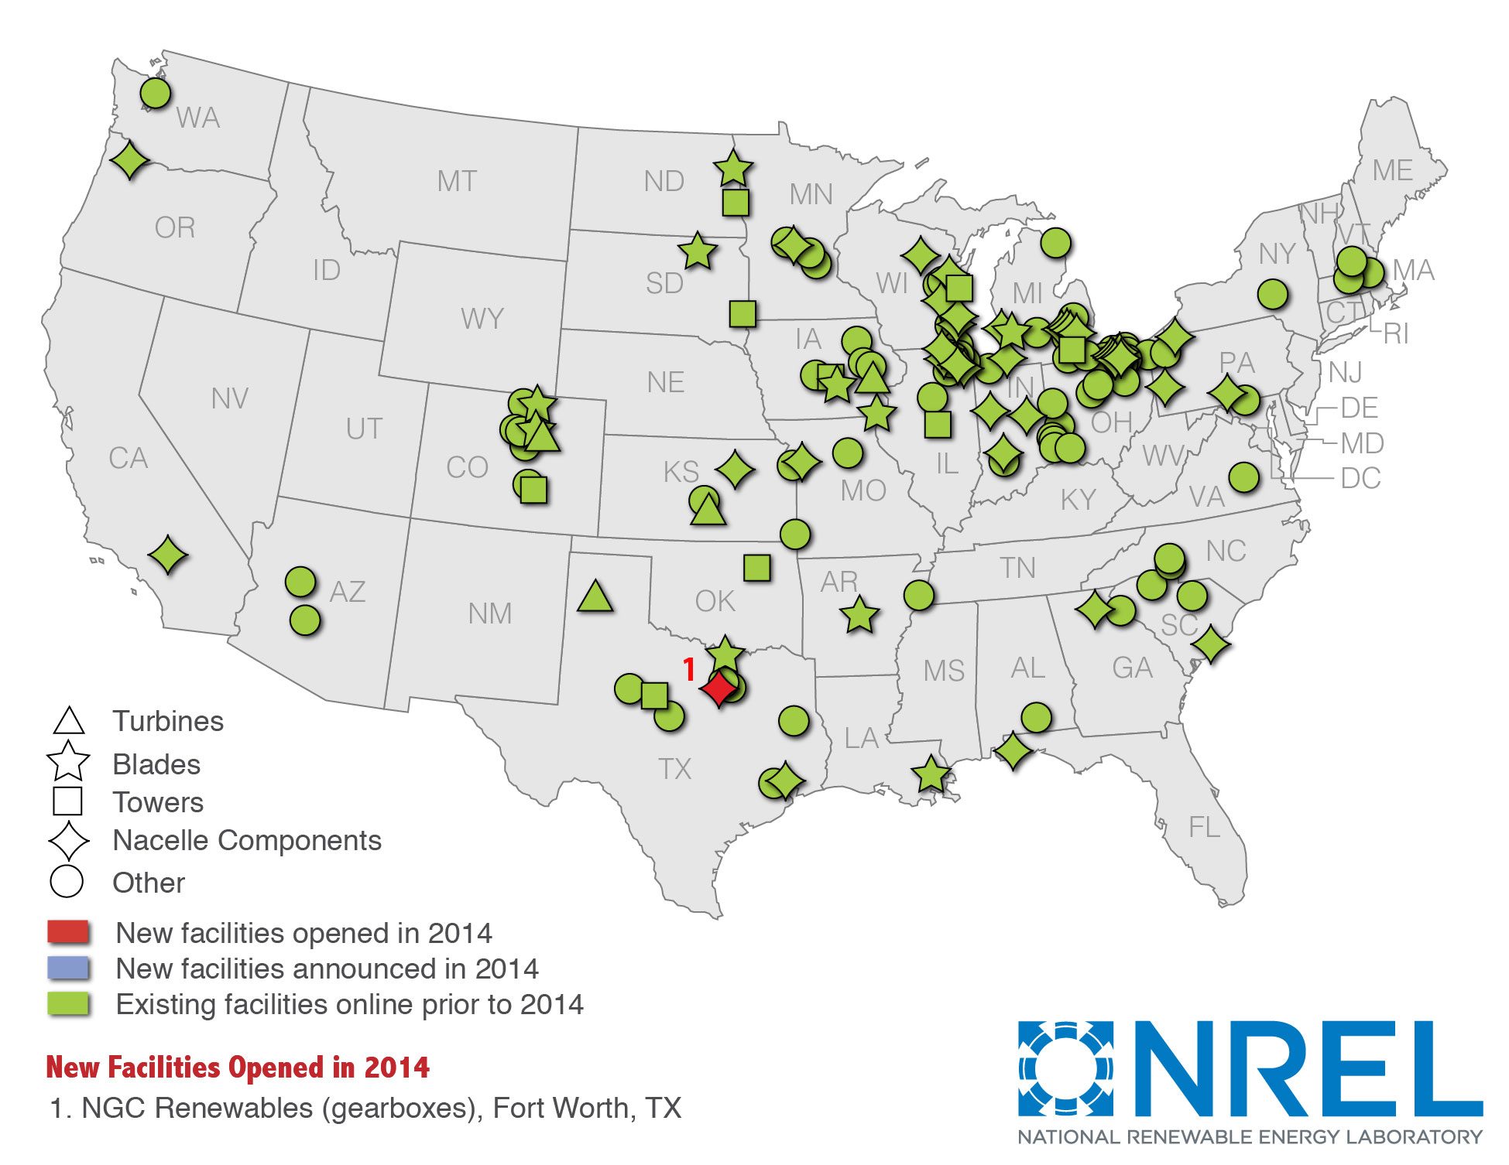
Manufacturing Supply Chain Continued to Adjust to Swings in Domestic Demand
Realignment Continued…
Uncertain medium-term demand and growing global competition led to 12 domestic manufacturing facility closures in 2014; only 1 new facility opened
Nonetheless, many supply chain manufacturers remain
Over last decade, manufacturers have localized and expanded U.S. presence
“Big 3” OEMs all still have at least one domestic facility
Wind related jobs increased from 50,500 in 2013 to 73,000 in 2014
Note: map not intended to be exhaustive

Slide 18
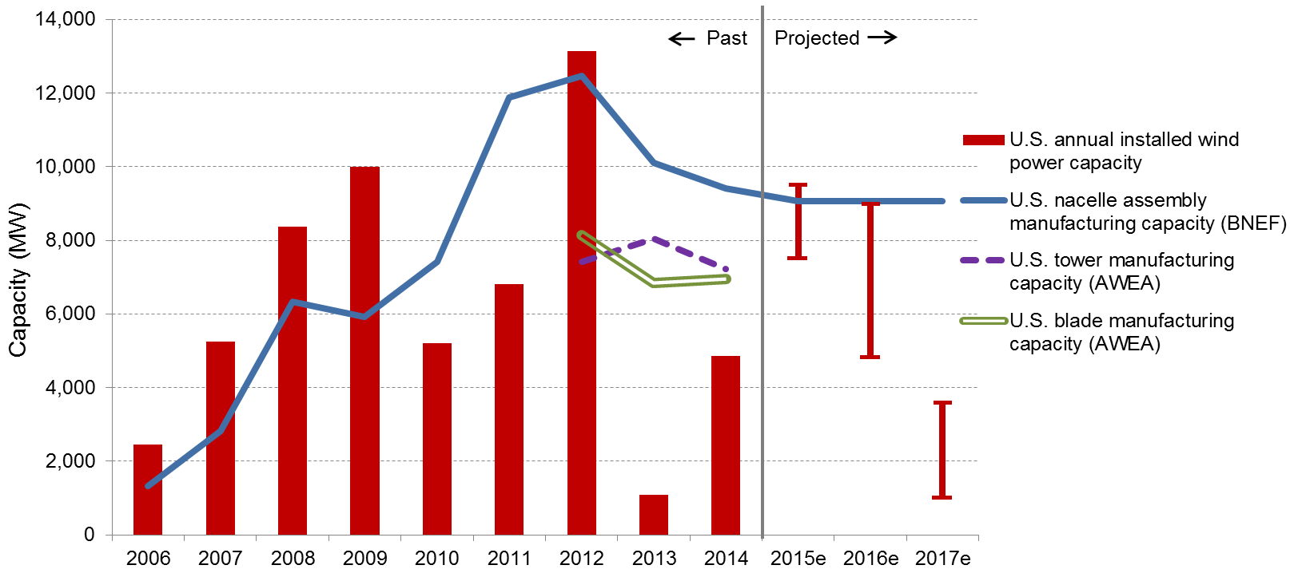
Domestic Manufacturing Capability for Nacelle Assembly, Towers, and Blades Is Reasonably Well Balanced Against Demand Forecasts for 2015 and 2016

Slide 19
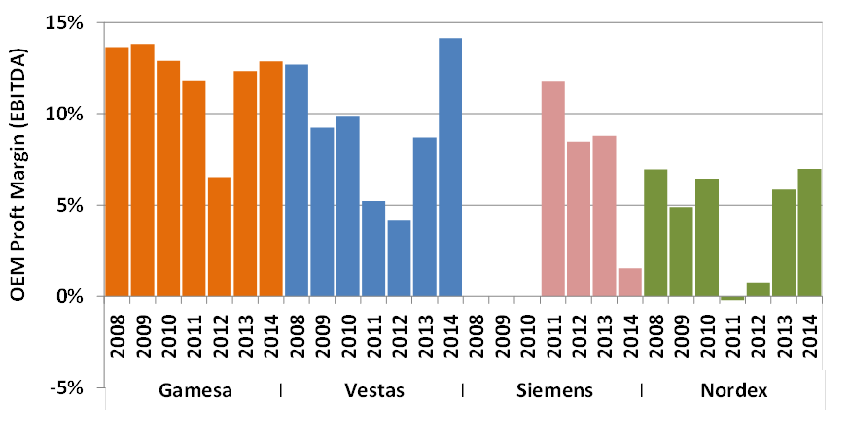
Turbine OEM Profitability Has Generally Rebounded Over the Last Two Years

Slide 20
Imports of Wind Equipment Are Sizable; Exports Continue to Grow Slowly
U.S. is a net importer of wind equipment
Exports of wind-powered generating sets increased modestly in 2014 to $488 billion; no ability to track other wind-specific exports, but total tower exports equalled $116 million
Figure only includes tracked trade categories; misses other wind-related imports
See full report for the assumptions used to generate this figure
Notes:
20

Slide 21
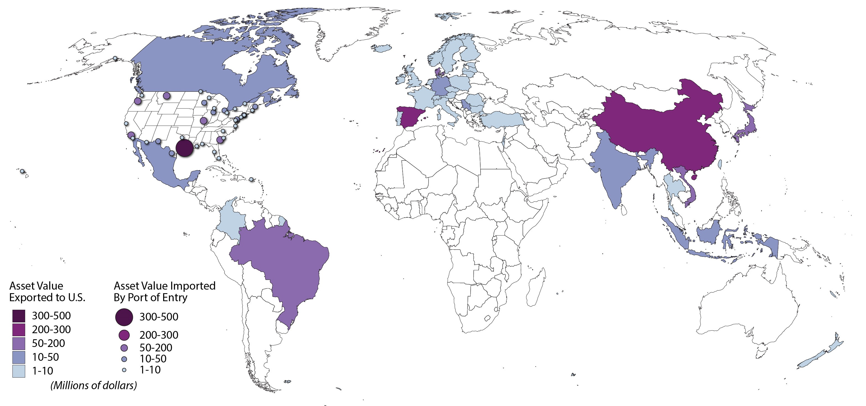
Tracked Wind Equipment Imports in 2014: 42% Asia, 39% Europe, 20% Americas
Note: Tracked wind-specific equipment includes: wind-powered generating sets, towers, hubs and blades, wind generators and parts.

Slide 22
Source Markets for Imports Vary Over Time, and By Type of Wind Equipment
Majority of imports of wind-powered generating sets from home countries of OEMs, dominated by Europe and Asia
Majority of imports of towers from Asia, but decline in recent years after tariff measures largely stopped imports from China and Vietnam
Majority of imports of blades & hubs from Brazil and China in recent years
Globally diverse sourcing strategy for generators & parts, dominated by Asian and European countries
Notes:
22

Slide 23
Domestic Manufacturing Content Is Strong for Nacelle Assembly, Towers, and Blades, but U.S. Is Highly Reliant on Imports for Equipment Internal to the Nacelle
Domestic Content for 2013 – 2014 Turbine Installations in the U.S.
Imports occur in untracked trade categories, including many nacelle internals
Overall estimated domestic content: ~40% in 2012 for wind turbine equipment; ~60% if considering total projects costs, including balance-of-plant
Notes:
23

Slide 24
The Project Finance Environment Remained Strong in 2014
Project sponsors raised $5.8 billion of tax equity (largest single-year amount on record) and $2.7 billion of debt in 2014
Tax equity yields held steady, while debt interest rates trended lower

Slide 25
Utility Ownership of Wind Rebounded Somewhat in 2014; IPPs Still Dominate

Slide 26
Long-Term Contracted Sales to Utilities Remained the Most Common Off-Take Arrangement, but Merchant Projects Continued to Expand, at Least in Texas
Recently announced wind purchases of ~2 GW from technology companies and business giants to hospitals, universities, and government agencies
Notes:
26

Slide 27
Technology Trends

Slide 28
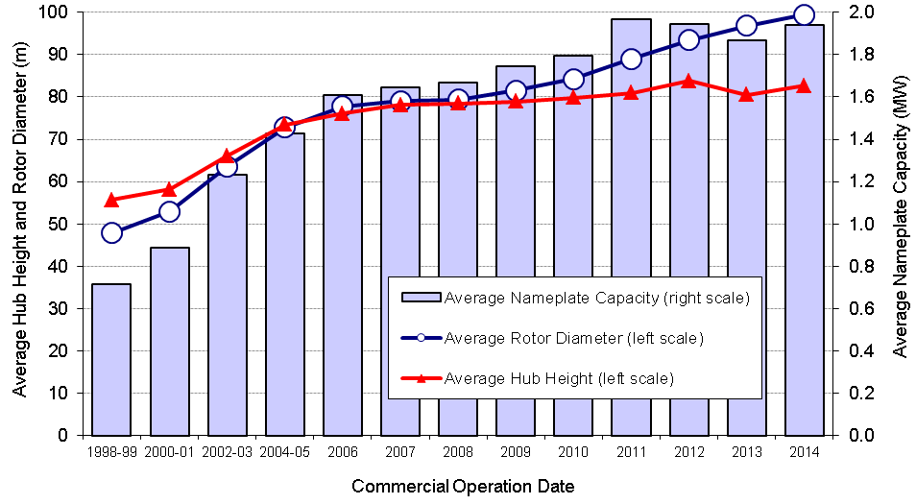
Turbine Nameplate Capacity, Hub Height, and Rotor Diameter Have All Increased Significantly Over the Long Term
Notes:
28

Slide 29
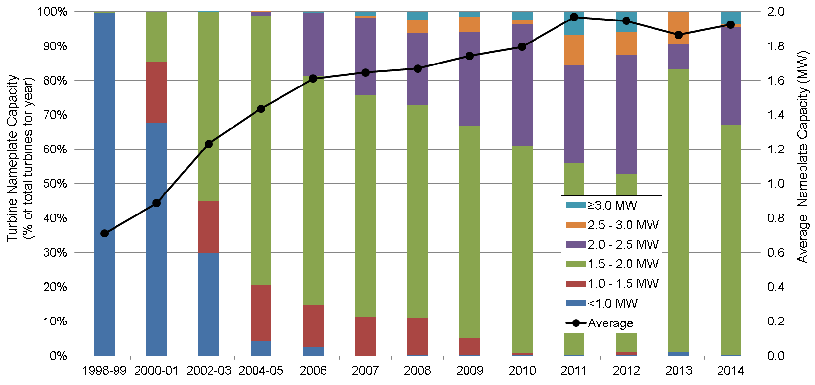
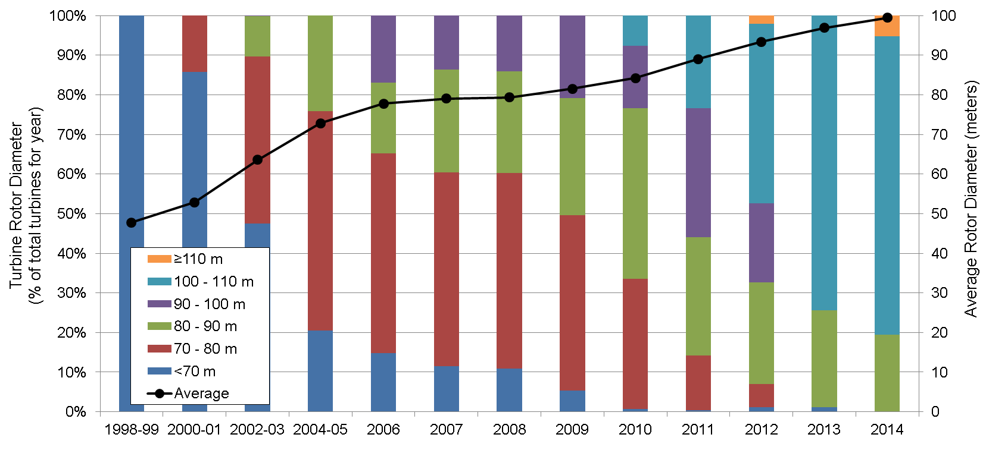
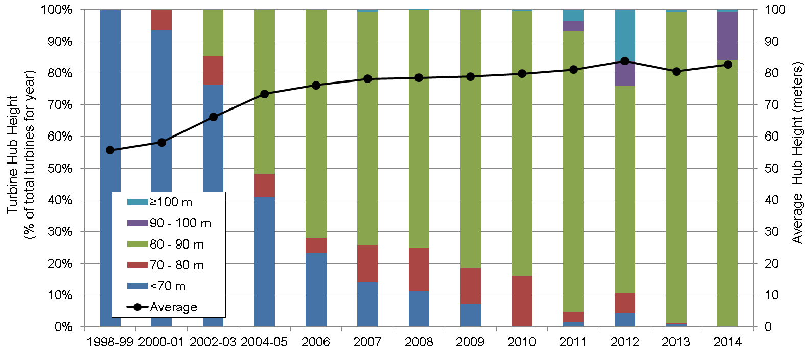
Growth in Rotor Diameter Has Outpaced Growth in Nameplate Capacity and Hub Height in Recent Years
Nameplate Capacity
Rotor Diameter
Hub Height
Notes:
29

Slide 30
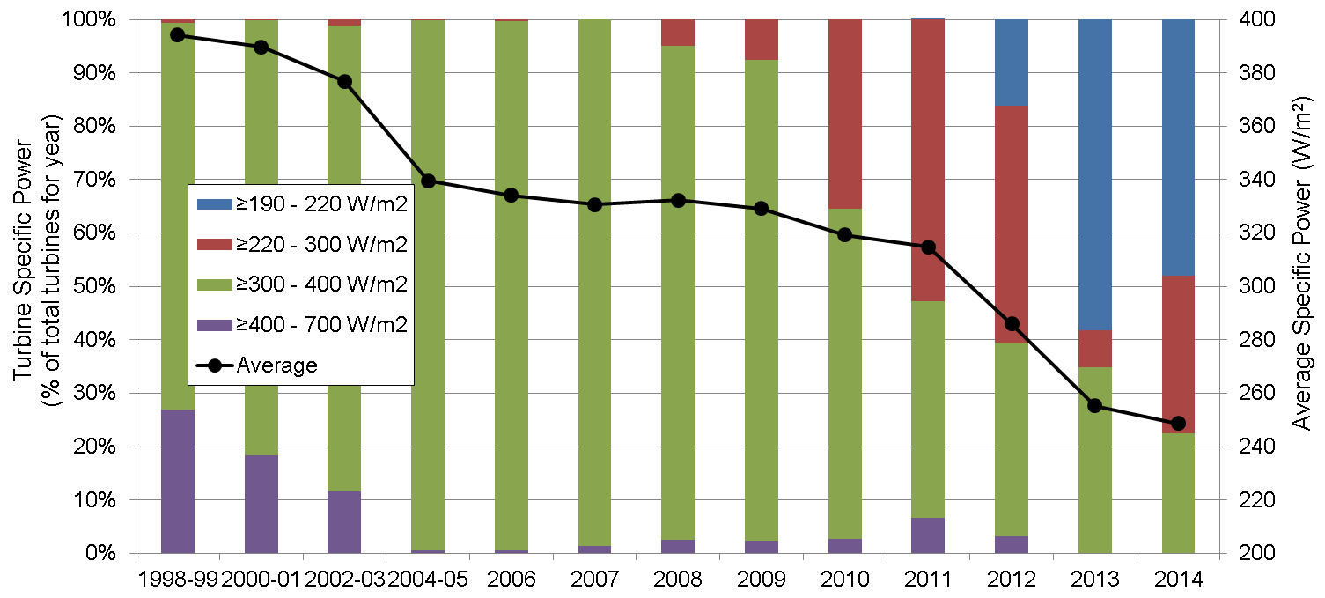
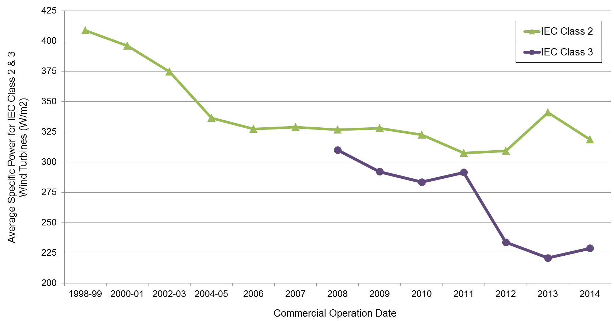
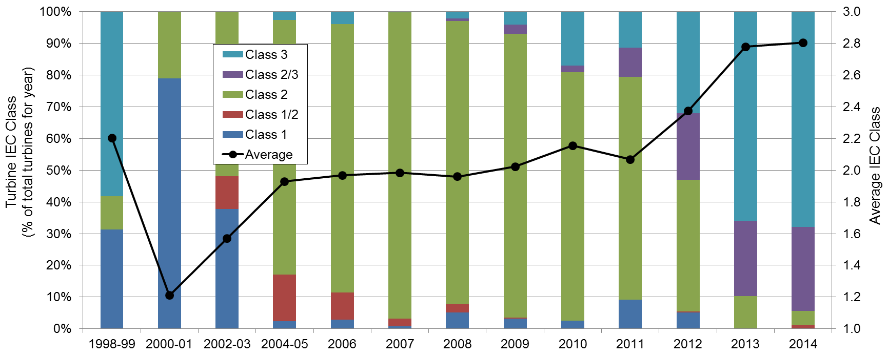
Turbines Originally Designed for Lower Wind Speed Sites Have Rapidly Gained Market Share
Specific Power
Specific Power by IEC Class 2 & 3
IEC Class
Notes:
30

Slide 31
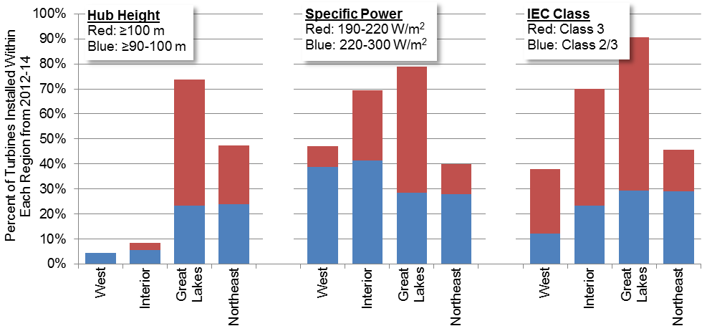
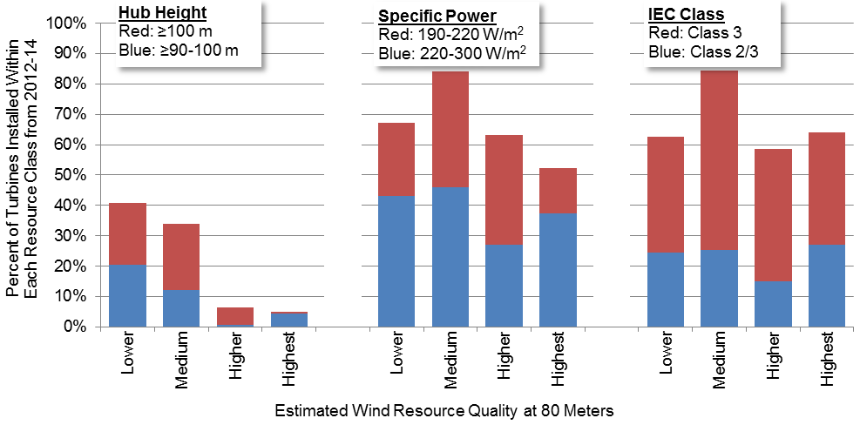
Turbines Originally Designed for Lower Wind Speeds Are Now Regularly Used in Lower and Higher Wind Speed Sites, Whereas Taller Towers Predominate in the Great Lakes and Northeast
By Region
By Wind Resource Quality
Notes:
31

Slide 32
Performance Trends

Slide 33
Sample-Wide Capacity Factors Have Increased, but Impacted by Curtailment and Inter-Year Wind Resource Variability
Note: The wind resource index is compiled from NextEra Energy Resources reports
Notes:
33

Slide 34
Wind Curtailment Has Generally Declined in Recent Years; Higher in MISO and New England than in Other Regions
Except for BPA, data represent both forced and economic curtailment
In areas where curtailment has been particularly problematic in the past – principally in Texas – steps taken to address the issue have born fruit

Slide 35
Even Controlling for These Factors, Average Capacity Factors for Projects Built After 2005 Have Been Stagnant, Averaging 32% to 35% Nationwide

Slide 36
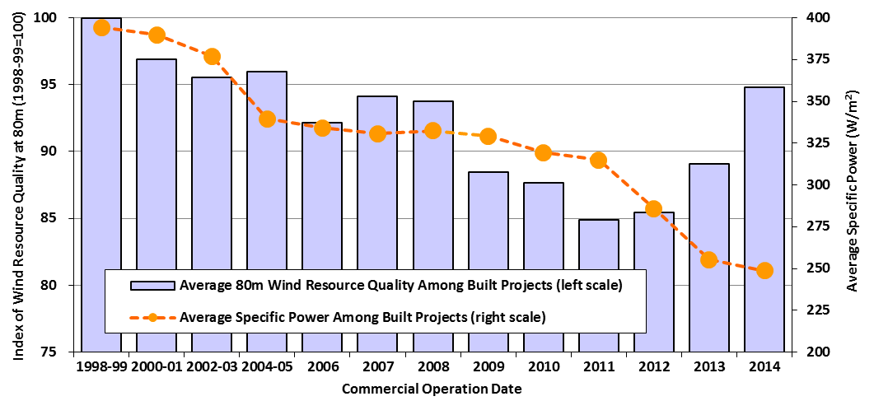
Trends Explained by Competing Influence of Lower Specific Power and Build-Out of Lower Quality Wind Resource Sites
Reversal of build-out in lower wind speed sites in 2013 and 2014: likely to show up in capacity factor data next year
All else equal:
Drop in average specific power will boost capacity factors
Building projects in lower wind resource sites will reduce capacity factors
Notes:
36

Slide 37
Controlling for Wind Resource Quality and Specific Power Demonstrates Impact of Turbine Evolution
Notwithstanding build-out of lower-quality wind resource sites, turbine design changes are driving capacity factors higher for projects located in given wind resource regimes
Notes:
revisions
37

Slide 38
Controlling for Wind Resource Quality and Commercial Operation Date Demonstrates Impact of Turbine Evolution
Notwithstanding build-out of lower-quality wind resource sites, turbine design changes are driving capacity factors higher for projects located in given wind resource regimes
Notes:
revisions
38

Slide 39
Regional Variations in Capacity Factors Reflect the Strength of the Wind Resource and Adoption of New Turbine Technology

Slide 40
Cost Trends

Slide 41
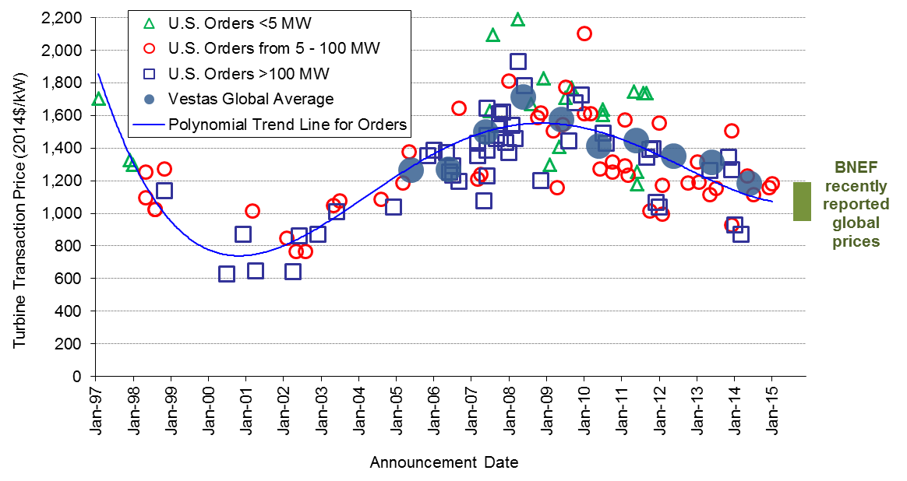
Wind Turbine Prices Remained Well Below the Levels Seen Several Years Ago
Recent turbine orders reportedly in the range of $850-1,250/kW

Slide 42
Lower Turbine Prices Drive Reductions in Reported Installed Project Costs
2014 projects had an average cost of $1,710/kW, down $580/kW since 2009 and 2010 (up slightly from small sample of 2013 projects)
Limited sample of under-construction projects slated for completion in 2015 suggest no material change in costs

Slide 43
Economies of Scale Evident, Especially at Lower End of Project & Turbine Size Range
Project Size
Turbine Size

Slide 44
Regional Differences in Average Wind Power Project Costs Are Apparent, but Sample Size Is Limited
Different permitting/development costs may play a role at both ends of spectrum: it’s easier/cheaper to build in the US interior and harder/more expensive along the coasts

Slide 45
Operations and Maintenance Costs Varied By Project Age and Commercial Operations Date
Capacity-weighted average 2000-14 O&M costs for projects built in the 1980s equal $34/MWh, dropping to $24/MWh for projects built in 1990s, to $10/MWh for projects built in the 2000s, and to $9/MWh for projects built since 2010
Note: Sample is limited, and consists of 147 wind projects totaling 10,350 MW; few projects in sample have complete records of O&M costs from 2000-14; O&M costs reported here DO NOT include all operating costs

Slide 46
Operations and Maintenance Costs Varied By Project Age and Commercial Operations Date
Note: Sample size is limited
O&M reported in figure does not include all operating costs: Statements from public companies with large U.S. wind asset bases report total operating costs in 2014 for projects built in the 2000s of ~$21-25/MWh

Slide 47
Wind Power Price Trends

Slide 48
Sample of Wind Power Prices
Berkeley Lab collects data on historical wind power sales prices, and long-term PPA prices
PPA sample includes 363 contracts totaling 32,641 MW from projects built from 1998-2014, or planned for installation in 2015 or 2016
Prices reflect the bundled price of electricity and RECs as sold by the project owner under a power purchase agreement
Dataset excludes merchant plants and projects that sell renewable energy certificates (RECs) separately
Prices reflect receipt of state and federal incentives (e.g., the PTC or Treasury grant), as well as various local policy and market influences; as a result, prices do not reflect wind energy generation costs

Slide 49
Wind PPA Prices Have Reached All-Time Lows, Dominated by Interior Region
Notes:
49

Slide 50
A Smoother Look at the Time Trend Shows Steep Decline in Pricing Since 2009; Especially Low Pricing in Interior Region
Notes:
50

Slide 51
Relative Competitiveness of Wind Power Improved in 2014: Comparison to Wholesale Electricity Prices
Wholesale price range reflects flat block of power across 23 pricing nodes across the U.S.
Price comparison shown here is far from perfect – see full report for caveats

Slide 52
Comparison Between Wholesale Prices and Wind PPA Prices Varies by Region
Notes: Wind PPAs included are those signed from 2012-2014. Within a region there are a range of wholesale prices because multiple price hubs exist in each area; price comparison shown here is far from perfect – see full report for caveats
Wind PPA prices most competitive with wholesale prices in the Interior region

Slide 53
Recent Wind Prices Are Hard to Beat: Competitive with Expected Future Cost of Burning Fuel in Natural Gas Plants
Price comparison shown here is far from perfect – see full report for caveats
Notes:
53

Slide 54
Renewable Energy Certificate (REC) Prices Remain High in Northeast, While Rising Modestly among Mid-Atlantic States
REC prices vary by: market type (compliance vs. voluntary); geographic region; specific design of state RPS policies

Slide 55
Policy and Market Drivers

Slide 56
Availability of Federal Incentives for Wind Projects Built in the Near Term Has Is Leading to a Resurgent Domestic Market, but a Possible Policy Cliff Awaits
Near-term availability of the PTC/ITC for those projects that reached the “under construction” milestone by the end of 2014 will enable solid growth in 2015 and 2016; uncertain prospects after that
Prospective impacts of more-stringent EPA environmental regulations, including those related to power-sector carbon emissions, may create new markets for wind energy

Slide 57
State Policies Help Direct the Location and Amount of Wind Development, but Current Policies Cannot Support Continued Growth at Recent Levels
29 states and D.C. have mandatory RPS programs
State RPS’ can support ~4-5 GW/yr of renewable energy additions on average through 2025 (less for wind specifically)

Slide 58
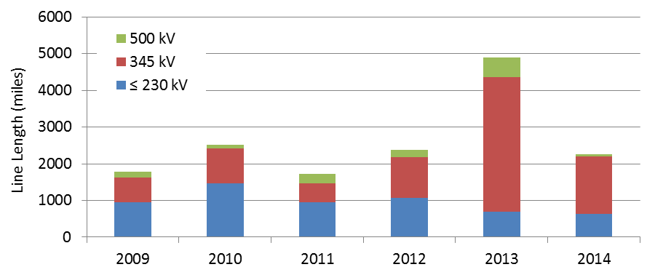
Solid Progress on Overcoming Transmission Barriers Continued
Over 2,000 circuit miles of new transmission built in 2014; lower than 2013 but consistent with 2009-2012
22,000 additional circuit miles proposed by March 2017, with half having a high probability of completion
AWEA has identified 18 near-term transmission projects that – if all were completed – could carry 55-60 GW of additional wind power capacity
FERC continued to implement Order 1000, requiring public utility transmission providers to improve planning processes and determine a cost allocation methodology for new transmission investments
Notes:
RYAN/KEVIN TO UPDATE

Slide 59
System Operators Are Implementing Methods to Accommodate Increased Penetrations of Wind
Integrating wind energy into power systems is manageable, but not free of additional costs
Notes: Because methods vary and a consistent set of operational impacts has not been included in each study, results from the different analyses of integration costs are not fully comparable. There has been some recent literature questioning the methods used to estimate wind integration costs and the ability to disentangle those costs explicitly, while also highlighting the fact that other generating options also impose integration challenges and costs.

Slide 60
Future Outlook

Slide 61
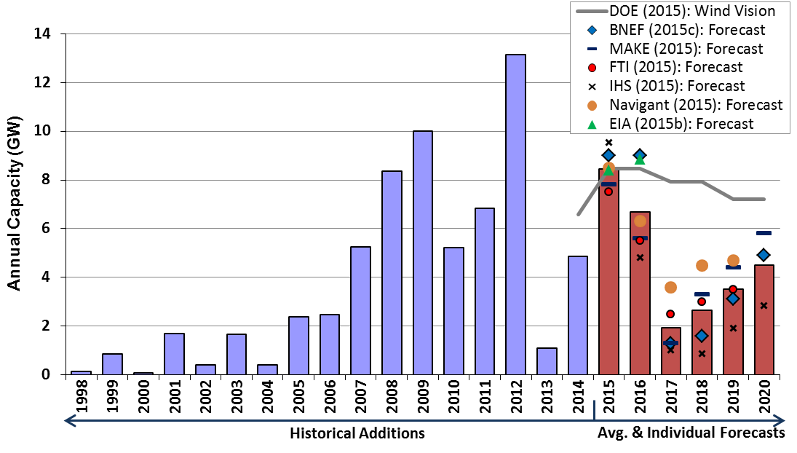
Sizable Wind Additions Anticipated for 2015 & 2016; Downturn and Increased Uncertainty in 2017 and Beyond
Wind additions in 2014 and anticipated additions from 2017-2020 fall below the deployment trajectory analyzed in DOE’s Wind Vision report
Notes:
61

Slide 62
Current Low Prices for Wind, Future Technological Advancement and New EPA Regulations May Support Higher Growth in Future, but Headwinds Include…
Lack of clarity about fate of federal tax incentives
Continued low natural gas and wholesale electricity prices
Modest electricity demand growth
Limited near-term demand from state RPS policies
Inadequate transmission infrastructure in some areas
Growing competition from solar in some regions
Notes:
62

Slide 63
Conclusions
Annual wind capacity additions rebounded in 2014, with significant additional new builds anticipated for 2015 and 2016
Wind has been a significant source of new electric generation capacity additions in the U.S. in recent years
Supply chain has been under duress, but domestic manufacturing content for nacelle assembly, blades, and towers is strong
Turbine scaling is boosting expected wind project performance, while the installed cost of wind projects is on the decline
Wind power sales prices have reached all-time lows, enabling economic competitiveness despite low natural gas prices
Growth after 2016 remains uncertain, dictated in part by future natural gas prices and policy decisions, though recent declines in the price of wind energy boost future growth prospects
Notes:
63

Slide 64
For More Information...
See full report for additional findings, a discussion of the sources of data used, etc.
http://energy.gov/eere/wind
To contact the primary authors
Ryan Wiser, Lawrence Berkeley National Laboratory 510-486-5474, RHWiser@lbl.gov
Mark Bolinger, Lawrence Berkeley National Laboratory 603-795-4937, MABolinger@lbl.gov
Berkeley Lab’s contributions to this report were funded by the Wind & Water Power Technologies Office, Office of Energy Efficiency and Renewable Energy of the U.S. Department of Energy under Contract No. DE-AC02-05CH11231. The authors are solely responsible for any omissions or errors contained herein.

